Slide 1
Content Management Systems
Kelly Schoonmaker
WDD 230
Notes:
Hello. I’m Kelly Schoonmaker and I will be doing m y presentation on Content Management Systems.

Slide 2
What is a Content Management System (CMS)?
Application used to manage HTML or other web content
Stores all web content in one place
Web page building for non-technical people
Collaborative work - assigns permissions for managing content based on roles such as authors, editors, and admins
Publish the content to a live page
Notes:
1st question is What is a Content Management system, often known as a CMS?
It an application to manage your web content: HTML, CSS, Javascript –Anything that you want on your web page
It stores that information, and also any media that you add, will be stored on the CMS
It is a great tool for people who don’t know coding to be able to build a webpage
Collaborative space, multiple people can work on a project, and have different levels of editing capabilities based on their role. Having multiple people can help speed up the process of getting a site up and running, and it also helps having peer review so that there are fewer errors.
Of course CMS has the capability to publish the content to a live page

Slide 3
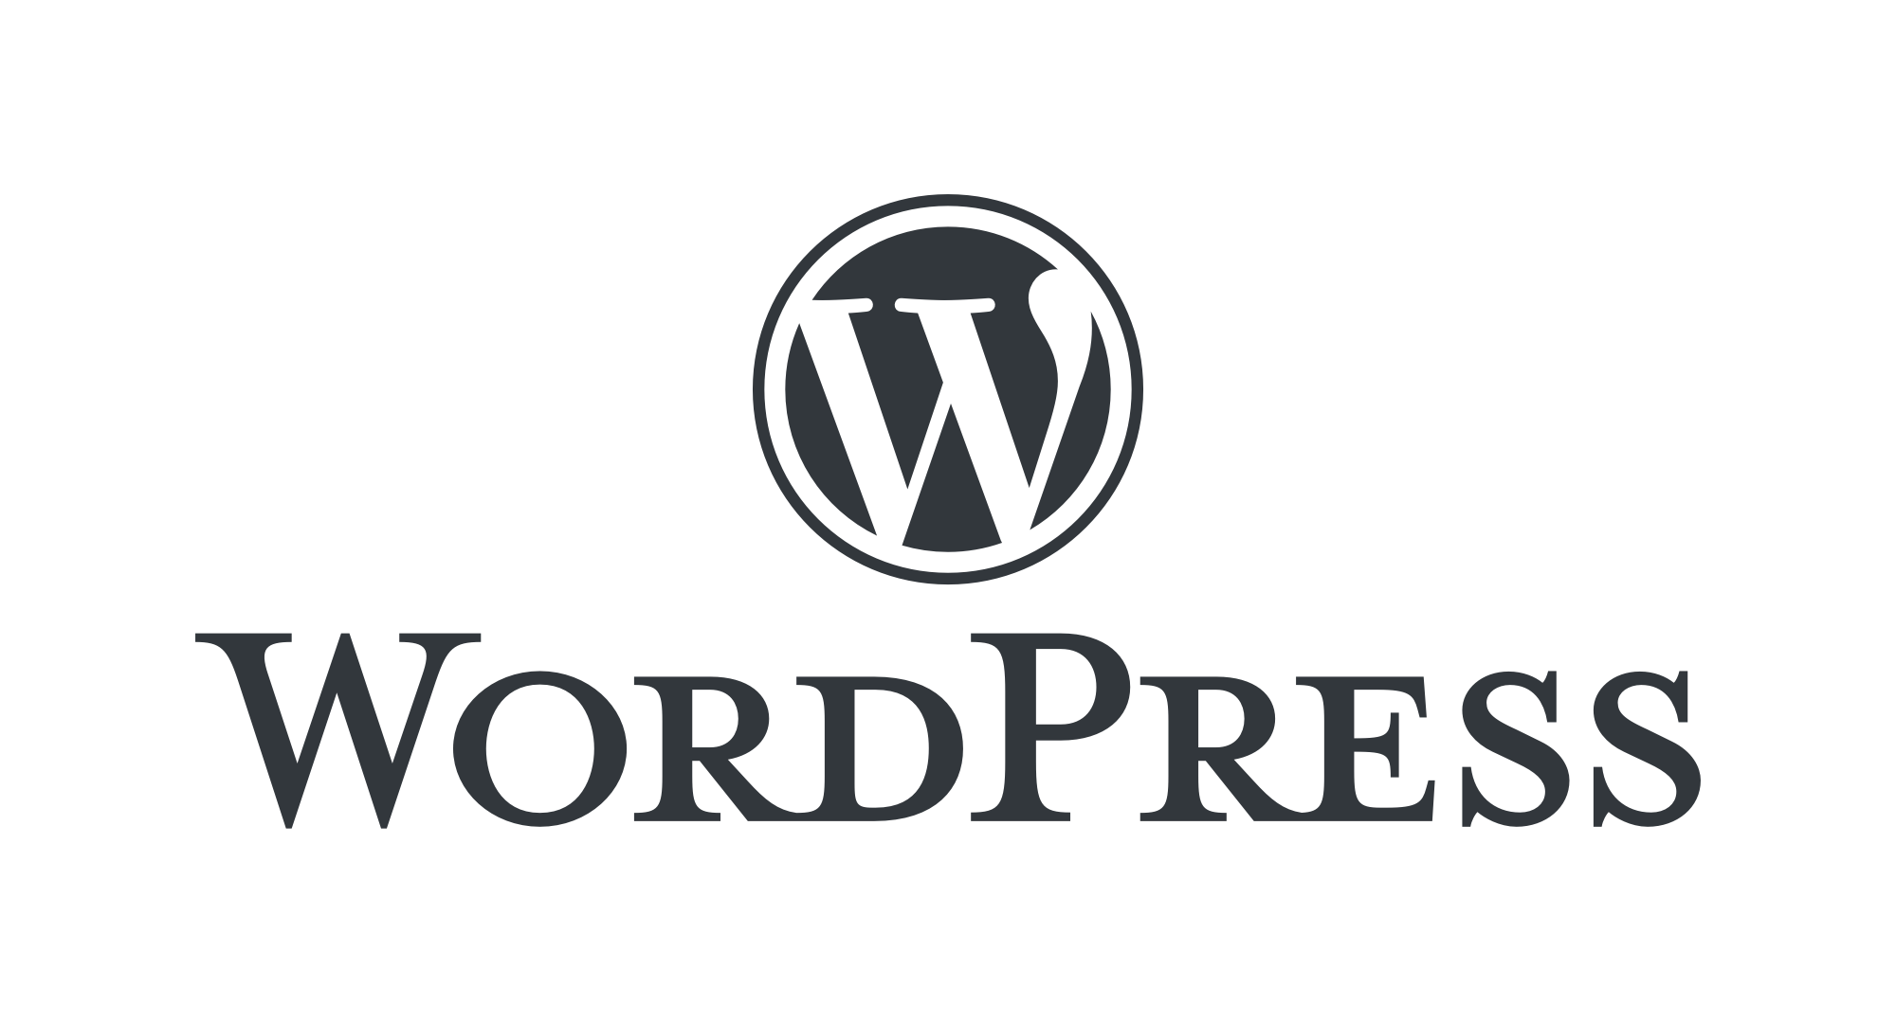
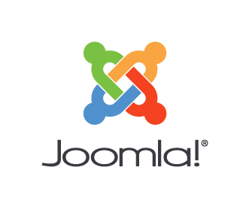


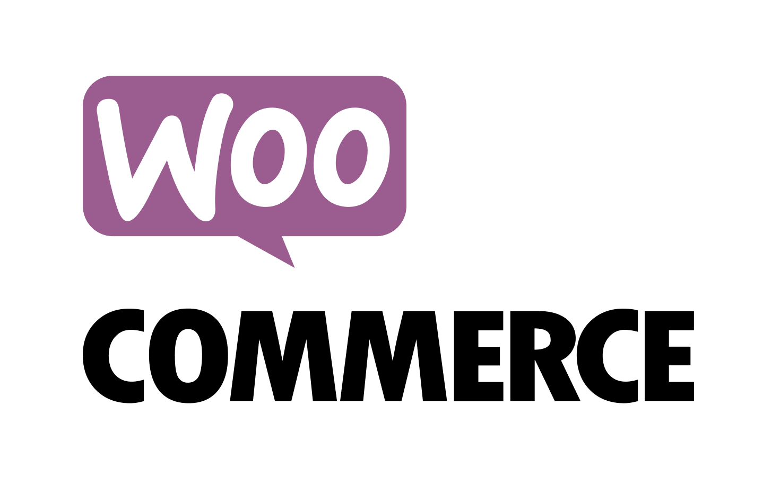


Different CMS platforms
Notes:
There are 1000s of Content Management Systems, but here a few of the most popular programs- list

Slide 4
What can a CMS do?
Blogging Capabilities
Media Publishing
User Registration
Contact Form Creation
E-Commerce Site
Calendar System
Event Management
Online Form Creation
Forum Capabilities
Notes:
Blogging capabilities –That was how word press started
Contact form creation- this takes the coding needed for that and makes it all available with one click, just adding the element on a CMS
E-commerce, Shopify is a huge Content Management System for online retail

Slide 5
Which CMS to use?
Make a list of requirements
Do research… lots and lots of research
Check for available extensions
Investigate design options
Dive in
Bluehost.com All About Content Management Systems
Notes:
Every project will be different, and each site has different purposes, and so there is no right answer on this. In order to find the right CMS for your particular project- MAKE a list of everything that your site will need to do.
Are you selling products? Do you need to have a sharable calendar app? Will users need to login to use the full site?
Once you have that list compiled look into the different CMSes. I would recommend starting with the larger CMSes because they are likely to have a more robust list a elements and capabilities available.
Next look into the available extensions, and cost of extensions that you would need for the site. This structure can look a little different depending on the CMS and could help you narrow down your choices.
Next look at the design options available, and make sure something will work with the design and feel of the brand that you are creating a webpage for.
Once you have selected a CMS just dive in. The best way to learn how to use a CMS is to just start.

Slide 6
CMS vs Coding
CMS Pros
CMS Cons
Faster development time
Easier to update and change products
Less maintenance time/costs
Slower loading time because it has to load apps for user adaptability
More monthly costs for access to the CMS
Notes:
One of the big questions I had when I started researching CMS is Why not just code it yourself?
Is it better to use a CMS or to hard code? Why?
Like so many things with web design-it depends. You can do it both ways. And some pages will be better hard coded and others with different needs will be a better fit for using a CMS
CMS is fast to get a page up. If you are on a tight timeline a CMS page can be up and running in very little time where hard coding takes more time.
Using a CMS makes it easier to update your page, or change products. If you have a page that is often updated or added to then a CMS makes sure that is done cleanly and quickly
Whenever you hard code something the likelihood of errors goes up. I’m not sure about the rest of you, but I know I have gotten error codes for forgetting a quotation mark or something else small. When that happens on a full page it can take some time to figure out the mistake and then to fix it. That time costs money, and using a CMS can prevent most of that cost.
On the other hand because a CMS has to be able to do so many things, it has a bunch of code that exists and can slow down the loading of a page. If you have a static, simple page that you want loading and running at the best speeds, then it might be a good idea to hard code.
Some CMS have a monthly/annual cost, and some extensions increase that initial cost as well, and so hard coding can save money on a simple site.
So look at each project and decide which it is best suited for CMS or hard coding.

Slide 7
DEMO
Notes:
Wordpress
I’m going to click add page, and then add a title. I’m going to call it Autumn Colors.
Now I click on this plus button and I can choose an element to add. As you can see there are a TON of options that you can add with one click. I’m going to choose tiled gallery and add some images. I simply select the ones I want to add to the page and hit upload. It adds the images in a beautiful gallery.
Now I can add another block and this time I going to choose a paragraph. Now assuming that was all I needed on this page I would click publish, or I can preview it first and make sure it looks the way I want it to. I can add different themes to give the page a totally different look
Another Very popular CMS is Shopify. Here is a page that is powered by Shopify
You can see the design options used by this company to create an awesome hover effect on the nav link, and once we click into one, lets try best selling it brings us to the items for sale. The images in each listing are the same size, and have a hover effect to show another image of the product, and also have the option to hover over the different style options of each product. You can image the amount of coding that would go into hard coding, just this page alone. But with a CMS it takes the customers all the way through the shopping and check out experience. You can see how a company that has a bunch of products, that often need to be added or removed would benefit by using a CMS.

Slide 8
Sources
Optimizely.com Content Management System. Accessed 10/12/2023 https://www.optimizely.com/optimization-glossary/content-management-system/#:~:text=A%20content%20management%20system%20(CMS)%20is%20an%20application%20that%20is,of%20templates%20like%20a%20website
Bluehost.com All About Content Management Systems. Accessed 10/12/2023 https://www.bluehost.com/blog/all-about-content-management-systems/?psafe_param=1&utm_campaign=pmax_PPC&utm_source=googleads&utm_medium=genericsearch&channelid=P61C101S570N0B5578A2D4499E0000V313&gclid=Cj0KCQjwsp6pBhCfARIsAD3GZuZiVPbjiUeiByfnFtxYpfhgP5gu8kpGb3v1pj8gTeUxGoGoJzAOukIaAkFlEALw_wcB&gclsrc=aw.ds
Muneneevans018.medium.com CMS or Hard Coding: Which is Best For Your Next Website. Accessed 10/12/2023 https://muneneevans018.medium.com/cms-or-hard-coding-which-is-best-for-your-next-website-5e7f85daf2ba#:~:text=CMSs%20Provide%20developers%20with%20pre,are%20much%20harder%20to%20build.

